Slide 1

MEDICAPS INSTITUTE OF TECHNOLOGY & MANAGEMENT
MAJOR PROJECT 2017-18
cryptography using selective encryption
Guided By: Submitted By:
Mr. Hariom Patidar Aman Thakur
Akshita Pathak
Submitted To: Akshanshi Jain
Mr. Ankit Saxena Abhinav Jha

Slide 2
CONTENTS
1. What is Cryptography
2. Security Attacks
3. Objectives of Information Security
4. Objective
5. Proposed System
6. Proposed concept
7. Selective encryption
8. Design – Steps or Planning
9. Milestone
10. Achievement
11. Advantages

Slide 3
What is Cryptography
Cryptography
In a narrow sense
Mangling information into apparent unintelligibility
Allowing a secret method of un-mangling
In a broader sense
Mathematical techniques related to information security
About secure communication in the presence of adversaries
Cryptanalysis
The study of methods for obtaining the meaning of encrypted information without accessing the secret information
Cryptology
Cryptography + cryptanalysis
Cryptography
In a narrow sense:
Mangling information into apparent unintelligibility
Allowing a secret method of un-mangling
In a broader sense:
Mathematical techniques related to information security
About secure communication in the presence of adversaries
Cryptanalysis
The study of methods for obtaining the meaning of encrypted information without accessing the secret information
Cryptology
Cryptography + cryptanalysis

Slide 4
Security Attacks
Passive attacks
Obtain message contents
Monitoring traffic flows
Active attacks
Masquerade of one entity as some other
Replay previous messages
Modify messages in transmit
Add or delete messages
Denial of service

Slide 5
Objective
Objective of this project is to build an efficient cryptography technique so as to provide security to the sent images and data. This security will be provided via encryption keys which will be different for data and image providing dual security. The receiver will only be able to access the data and image if the decryption key matches the original key.
Objectives of Information Security
Confidentiality (secrecy)
Only the sender and intended receiver should be able to understand the contents of the transmitted message
Authentication
Both the sender and receiver need to confirm the identity of other party involved in the communication
Data integrity
The content of their communication is not altered, either maliciously or by accident, in transmission.
Access control
An entity cannot access any entity that it is not authorized to.
Anonymity
The identity of an entity if protected from others.

Slide 6
Objective
Objective of this project is to build an efficient cryptography technique so as to
provide security to the sent images and data. This security will be provided via encryption keys which will be different for data and image providing dual security. The receiver will only be able to access the data and image if the decryption key matches the original key.

Slide 7
Proposed System
The proposed scheme is made up of image encryption, data embedding and data-extraction/image-recovery phases. In our project we implement the key generation by using SELECTIVE ENCRYPTION. We give additional password to decrypt our image.

Slide 8
PROPOSED CONCEPT
The content owner encrypts the original uncompressed image using an encryption key to produce an encrypted image.
Then, the data-hider compresses the Least Significant Bits (LSB) of the encrypted image using a data-hiding key to create a sparse space to accommodate the additional data.
At the receiver side, the data embedded in the created space can be easily retrieved from the encrypted image containing additional data according to the data-hiding key. Since the data embedding only affects the LSB, a decryption with the encryption key can result in an image similar to the original version.
When using both of the encryption and data-hiding keys, the embedded additional data can be successfully extracted and the original image can be perfectly recovered .

Slide 9
SELECTIVE ENCRYPTION ALGORITHM FLOWCHART
INPUT IMAGE
IMAGE ENCRYPTION
ENCRYPTION KEY
INPUT ADDITIONAL DATA
HIDE ADDITIONAL DATA
DATA KEY
RECEIVE ENCRYPTED DATA
TRANSMIT
DATA KEY
ENCRYPTION KEY
DECRYPT IMAGE
DECODE DATA

Slide 10
Selective encryption Method
Selective encryption scheme generate the key before starting the process of encryption and decryption, rather than storing.
The image is first compressed. Afterwards the algorithm only encrypts part of the bit stream with a well-proven ciphering technique; incidentally a message can be added during this process. To guarantee a full compatibility with any decoder, the bit stream should only be altered at places where it does not compromise the compliance to the original format. This principle is sometimes referred to as format compliance.

Slide 11
There are two way of encrypting an image i.e. shuffling the pixels of the image or
substituting the pixel of the image. For this purpose we use confusion and
diffusion, in confusion the pixels of the image are replaced by another value and
in the process of diffusion the pixel values are shuffled within the image. These
two processes are used in the algorithm for key generation.
The Chaos based technique is widely studied and we define a selective encryption
technique for partial image encryption. Selective encryption is carried out with the
help of chaos map. The encryption is carried out in two stages:
1. Chaos based key generation
2. Selective Encryption
These two techniques are performed independently and at the end these
technique are merged together.

Slide 12
Selective encryption Procedure
Selective encryption technique is carried out in two steps as shown in Figure,
generation of key with the help of confusion and diffusion, and selective
encryption. In this algorithm,
we proposed a technique for selective image encryption by confusion and diffusion
using chaos map.

Slide 13
Design – Steps
The below flowchart shows the design steps
IMAGE INITIALISATION
IMAGE ENCRYPTION
DATA EMBEDDING
DATA EXTRACTION & IMAGE RECOVERY
GUI FORMAT

Slide 14
Advantages & Application
Authentication/Digital Signatures Stamping
Anonymous Remailers
E-commerce
Sending private e-mails
Transmitting financial
Military Communications

Slide 15
Milestones There were several milestones set some of few are listed below: 1. Input Image initialization 2. Generation of image encryption key and Image Encryption 3. Data embedding in the input image 4. Generation of data hiding key 5. Recovering data and image 6. Calculation of Peak Signal to Noise Ratio
Achievements
The milestones are successfully achieved. The image is encrypted using encryption key and data is embedded in the image. The data is hidden with the help of data hiding key. Furthermore after the completion of encryption process the data and image is retrieved back by applying the decryption key.

Slide 16
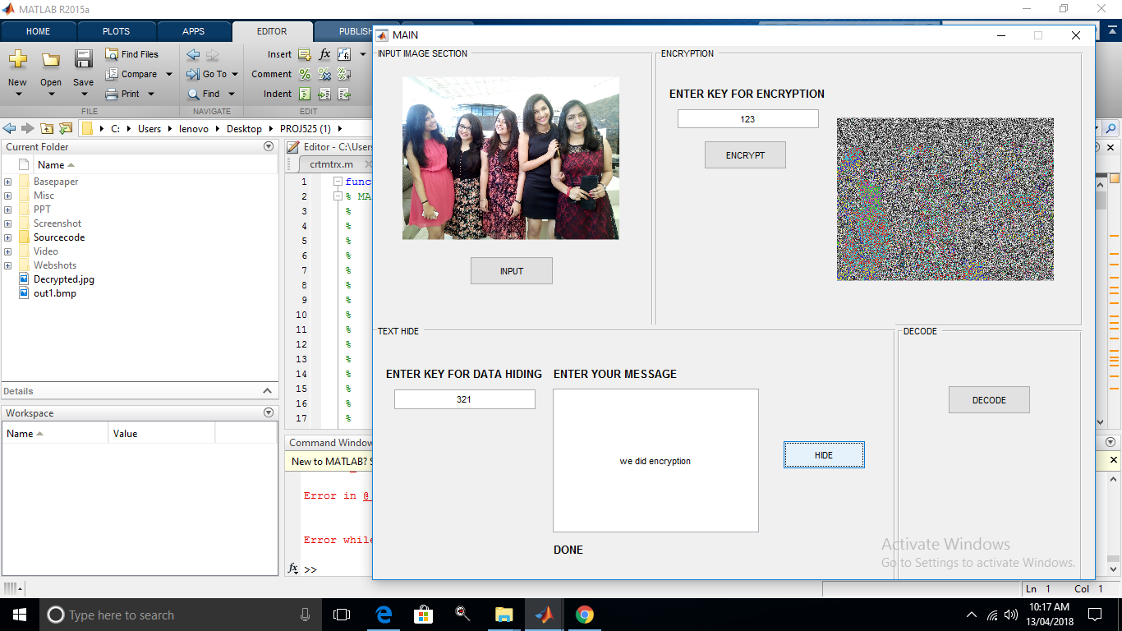
OUTPUT
This image includes the process of Input Image Initialization, Generation of
Encryption key, Data Embedding and Generation of Data hiding key.

Slide 17
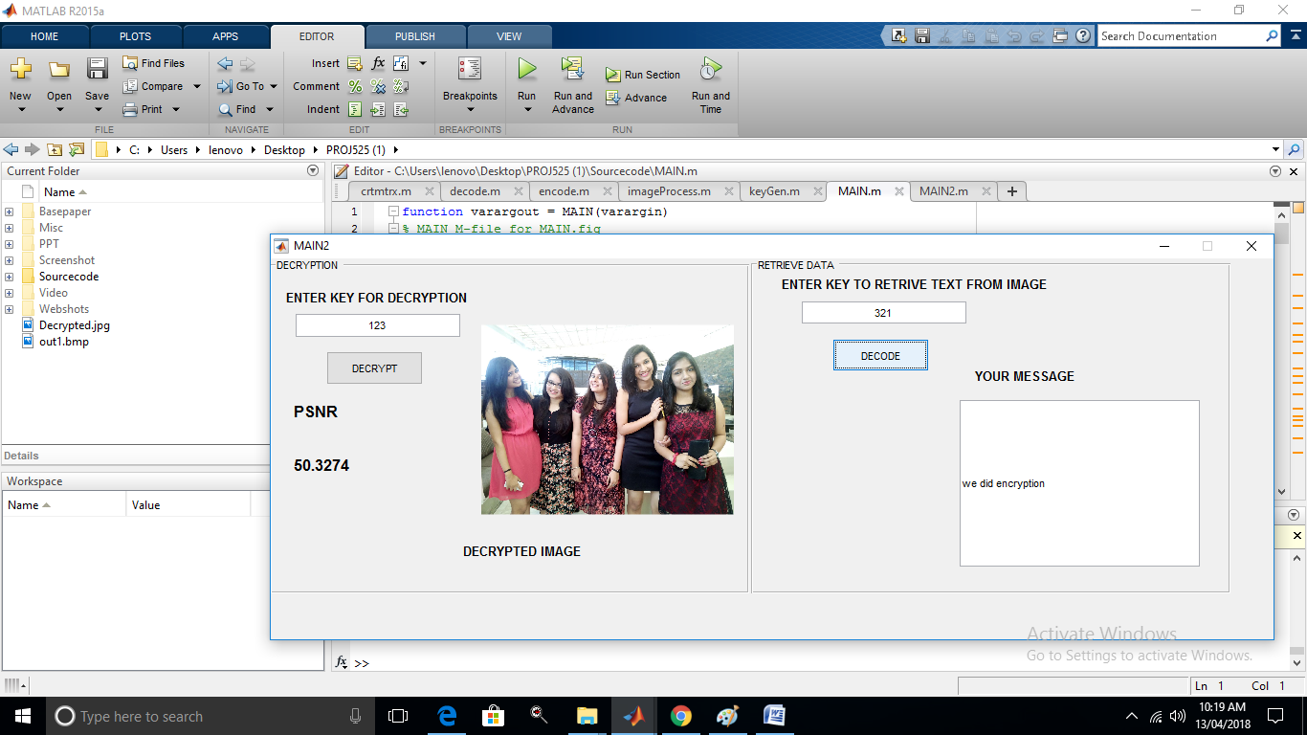
This image includes the process of Extraction of Image and the Data independently by
applying Decryption key. Also calculation of PSNR value is done.

